Slide 2
A New Focus on Accountability –
ECFA
Missio Nexus
September 20, 2019

Slide 3
ECFA History
﻿ECFA’s history reminds us
—and future generations—
of God’s faithfulness.

Slide 4
ECFA History
﻿“When you’re publicly accountable,
people feel more comfortable about you.
They won’t tend to accuse you of hiding funds or doing other things wrong financially.”
Stephen Douglass, President, Cru

Slide 5
ECFA History
﻿“Government intervention is too often
like a female elephant that saw an untended nest
of quail eggs beside the road.
The nest aroused her maternal instincts,
which she immediately expressed by
sitting on the eggs. Her motivation may have been unquestionably pure, but there is no question
that the result was somewhat extreme!”
Stan Mooneyham, Past President, World Vision International

Slide 6
ECFA History
﻿“As the infant ECFA stepped up to face
the decade of the 1980s, only God could see
the gargantuan challenge PTL would present.”
Dan Busby, ECFA President

Slide 7
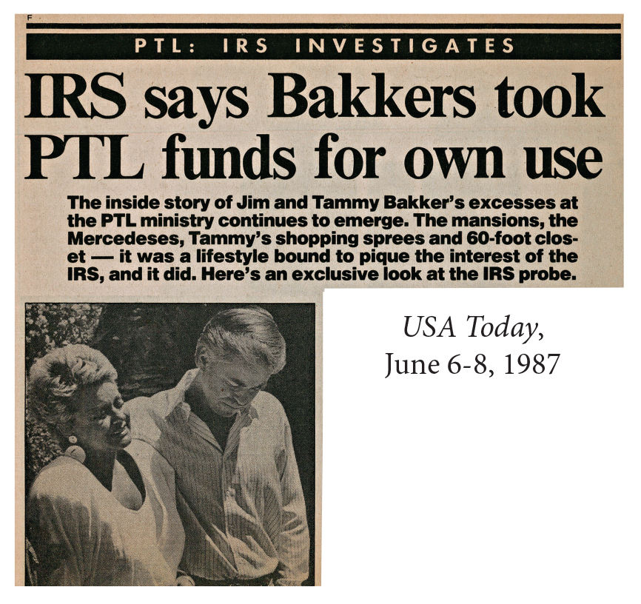
PTL Scandal

Slide 8
ECFA History
﻿“I was prepared for the worst things I might encounter
seeing the underbelly of Christian organizations,
but less prepared for the salt-of-the-earth people
who would never do anything to harm the cause of Christ.
They had little notoriety.
They were just there to help people in need.
They were the people that definitely were inspiring to me.”
Paul Nelson, ECFA Former President

Slide 9
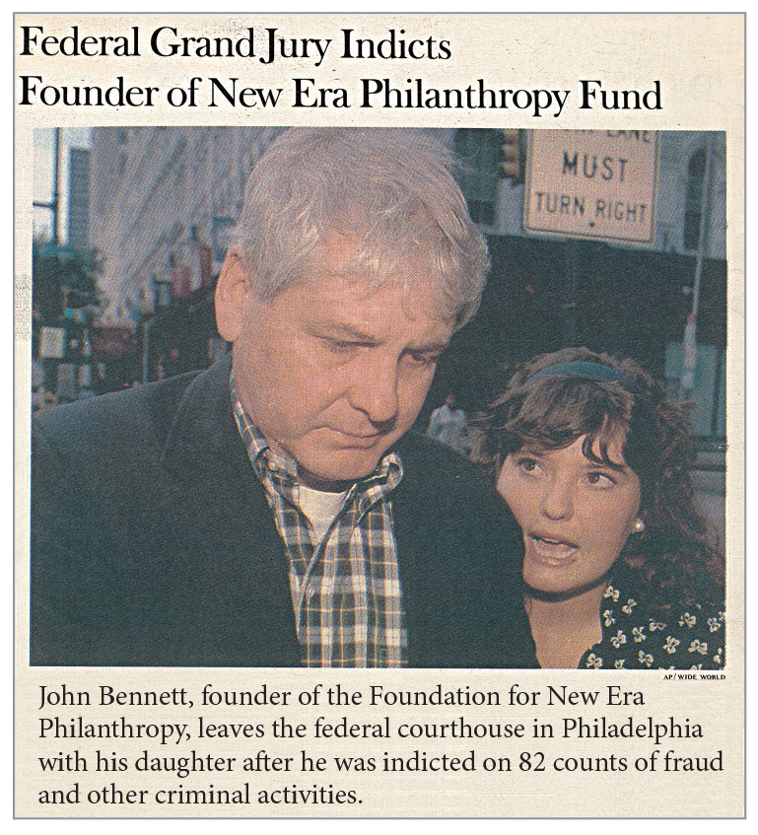
New Era

Slide 10
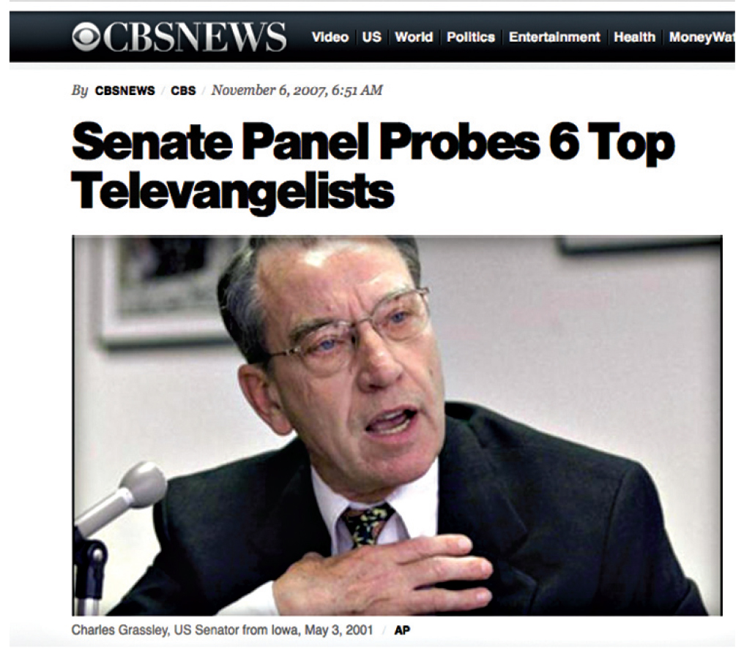
Grassley Probe

Slide 11
ECFA Membership Growth

